Slide 1
Final project Presentation Muslit Alotaibi

Slide 2
Introduction
The main goal of this project is to implement a simple algorithmic model that predicts the score of an individual students at the end of the year and & understand what the data is telling us through visualizations (plotly, matplotlib, seaborn).

Slide 3
Outline of the Project:
1) Extract the Data and Gather General Information of the Dataset 2) Visualize the three outputs ["G1", "G2" and "G3] 3) Data Structuring: 4) Data Analysis and Visualization 5) Data Cleaning (Preparing the Data for our Algorithm)
6) Conclusion

Slide 4
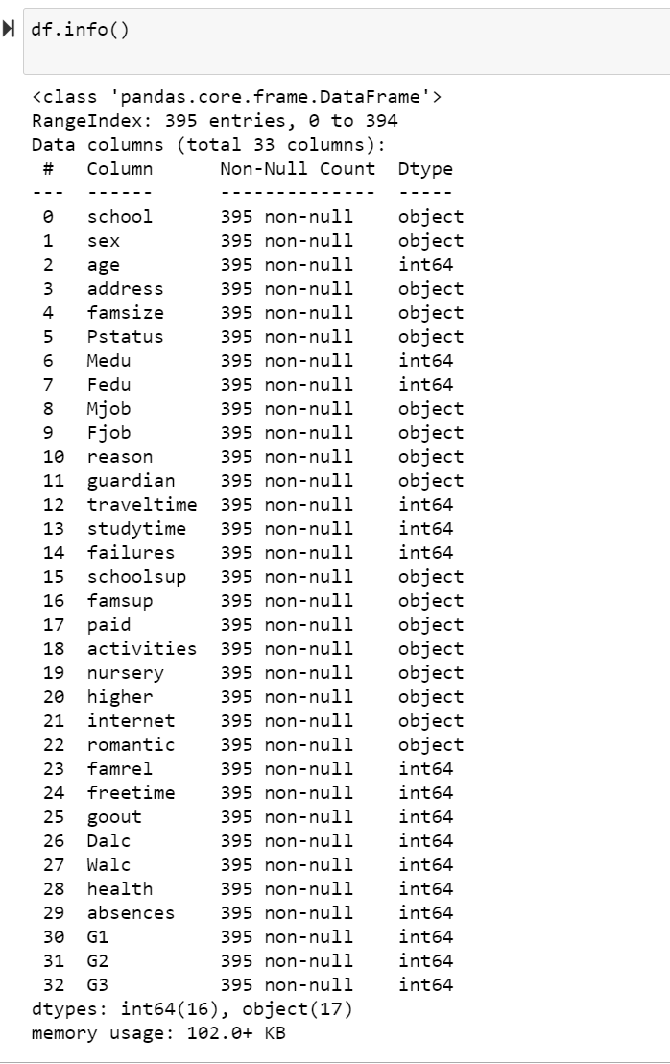
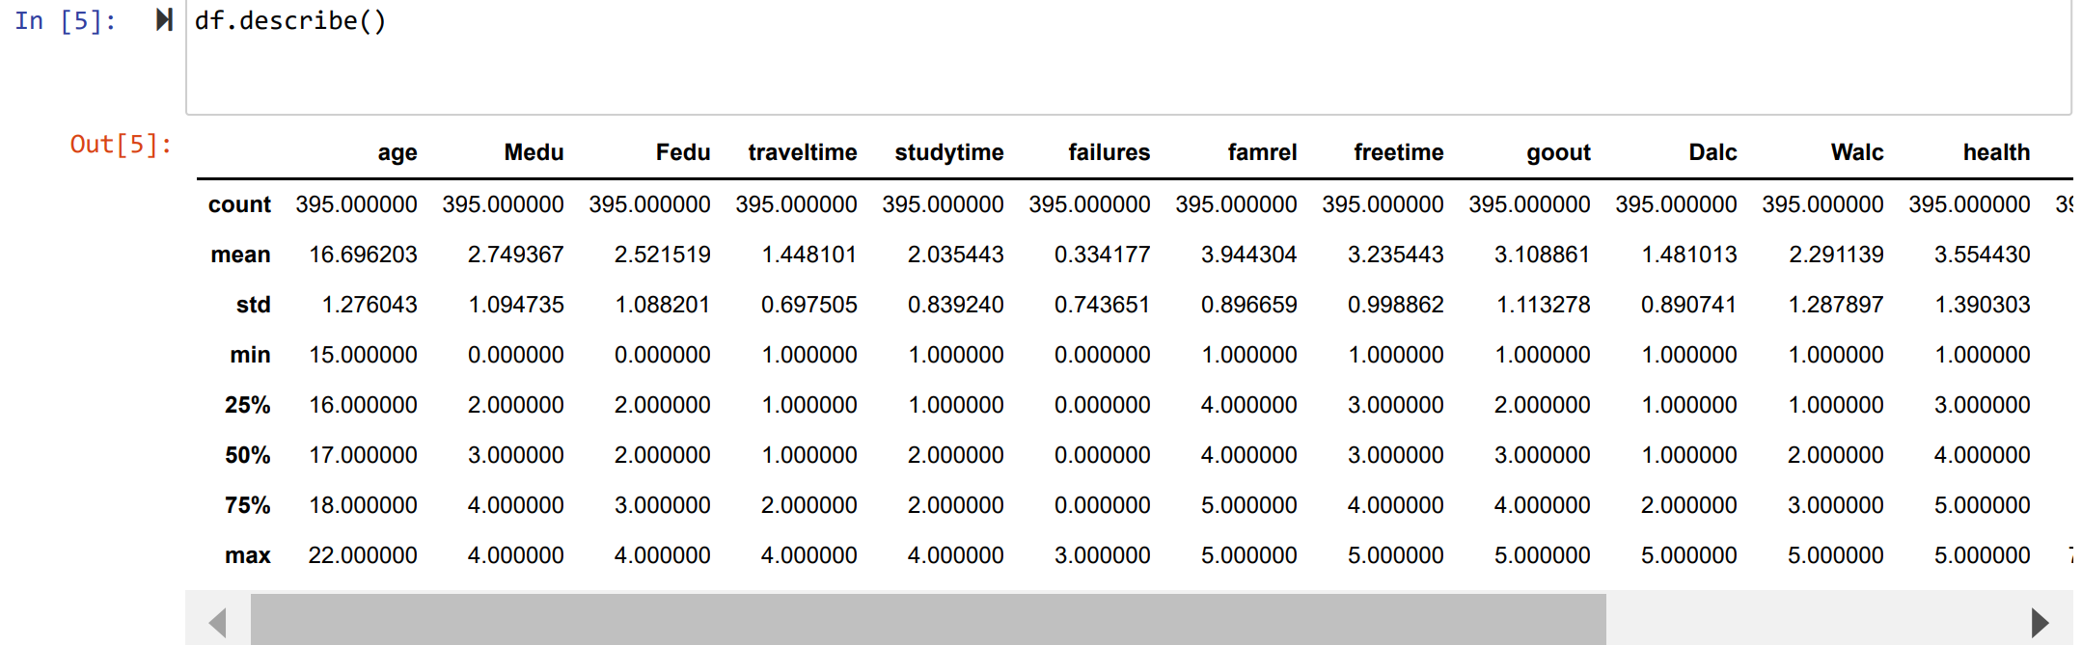
Exploring the Information of the DataFrame
To see if we have any null values in the dataset. As you can see there are 395 rows in each of the columns so that means there are no null values.
2) It is important to know if we have any null values because in case we do have we have to find a way to fill the null values normally we do this with the ("mean", "median", "mode" or we just drop the rows that contain null values.) Normally this can be done using sklearn Imputer.

Slide 5
Visualization
Distribution Plots with Plotly:
The distribution plots is to visual & see how many students passed in G1 [First Period], G2 [Second Period], and
G3 [Last Period].
Assuming that
everything lower than 12 is a "Failing Grade". If the grade is greater or equal to 12 then this will be a "Passing" grade.

Slide 6
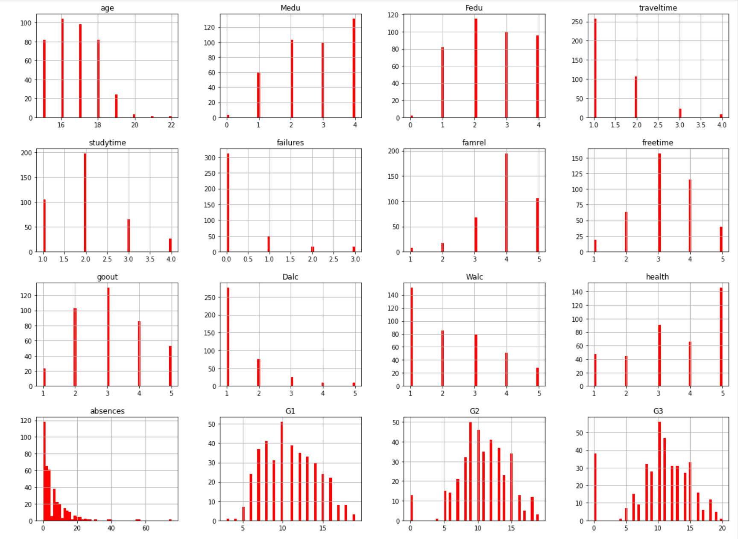

Slide 7
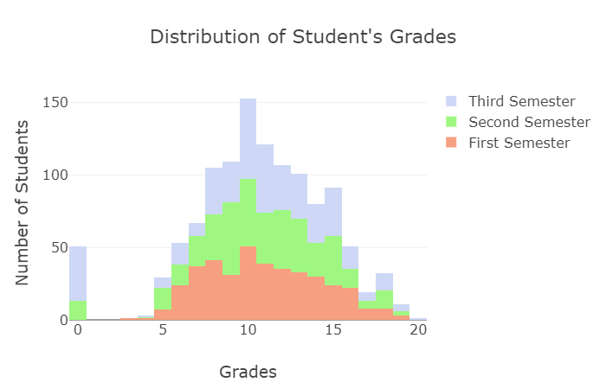
What can we gather from this Data? 1) Did students that failed in the first period improved in the second and third period? 2) How many students got each grade and what grade did most of the students got. 3) In which of the periods did students failed the most.

Slide 8
Data Cleaning
Dropping Columns that are not highly correlated
1) Here we will find out the columns that are highly correlated (either positively or negatively) in order to leave it in our dataframe. 2) We should have a criteria in order to retain the columns. Let's say if the column is correlated more than 8% to G3 we retain the column for further analysis. 3) Some columns that are not highly correlated might stay to see if we could develop new features by combining 2 or more columns. 4) We will drop the columns G1 and G2 since we already know this is highly indicative of what G3 will be. We want to find out other features that could have a positive impact 5) The columns that are in binary format we will convert it into numeric in a new column to see if they have a high correlation with G3.

Slide 9
What binary columns influenced the G3 grade:
1) Higher education [higher]: Students that were aiming in having a higher education tended to get better results in the final grade. However, we have to take into consideration that only 20 students were not aiming for higher education. Nevertheless, this feature can give us a hint as to whether a student will get higher grades or not.
2) Paid extra Classes [paid]: These are the extra paid classes within the course sibject. It has a positive correlation whichmeans the more the students took the extra classes the more likely they were to pass.
3) People in a relationship [romantic]: The people that were not in a romantic relationship tended to get higher grades than the ones that were in a relationship.

Slide 10
This will reduce the amount of columns Making our Dataframe much simpler and hopefully we will avoid overfitting.

Slide 11
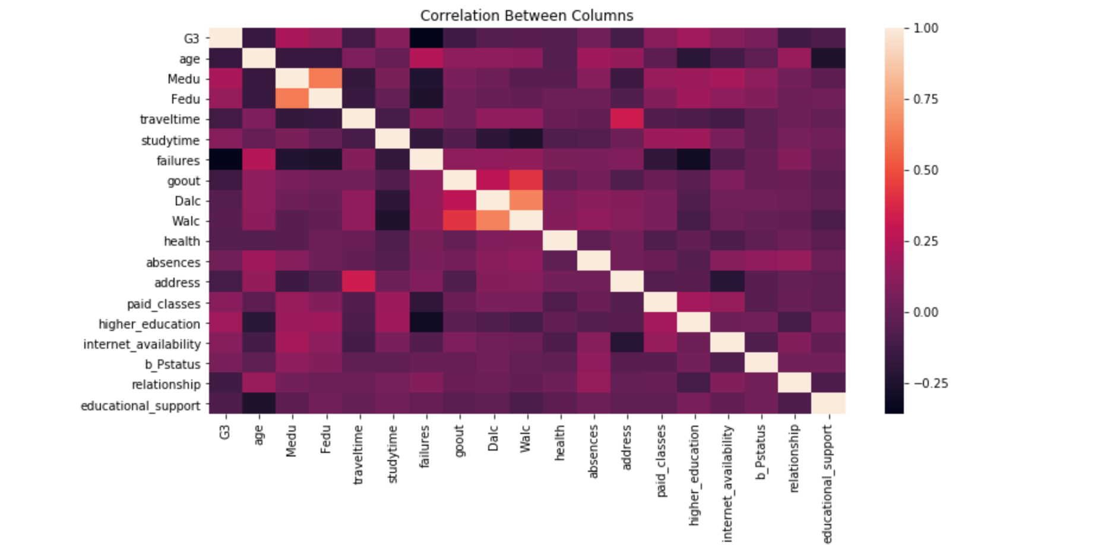
Heatmap & positive , negative correlation

Slide 12
Developing the Algorithms
pre-process the categorical values
split the numerical and categorical values to fit it into our Linear Regression Model.
Transform our numeric values into a StandardScaler form for better performance of the linear regressoin model, this is done using pipeline to automize the steps for the linear regression model.

Slide 13
Conclusion
In this project we did a deep analysis of what could be possible factor on whether a student is likely to get a high score or a low score. The data we have does not contain that much information but still we were able to predict a pretty precise RandomForest Regressor algorithm that predicts what score a student will get in the foreseen feature by analyzing the features.

